Slide 1

Corporate law and economics (LL4489V/5489V/6489V) 6. exit vs voice
LL4489V
Kenneth Khoo
kenneth.khoo@nus.edu.sg

Slide 2

Exit vs voice
General Principles
Motivation
Diversification in Financial Markets
Theoretical Foundations
Empirical Evidence
Applications to Law

Slide 3
Motivation
Recall: In our last lecture, we discussed the idea that shares themselves are proprietary in nature (as choses in action), but that the rights attached to them are contractual.
Cambridge Gas Transport Corp v. Official Committee of Unsecured Creditors [2006] UKPC 26: “A share is the measure of the shareholder's interest in the company: a bundle of rights against the company and the other shareholders. As against the outside world, that bundle of rights is an item of property, a chose in action. But as between the shareholder and the company itself, the shareholder's rights may be varied or extinguished by the mechanisms provided by the articles of association or the Companies Act.”
Given the proprietary nature of shares, it may be possible to transfer these shares to other individuals external to the corporation. These individuals are often known as “prospective shareholders”.
S 121 of the Companies Act: “The shares or other interest of any member in a company shall be movable property, transferable in the manner provided by the constitution, and shall not be of the nature of immovable property”
This vests transfer rights in shares as a default rule.

Slide 4
Motivation
In listed corporations, shares must be freely transferable (In Singapore, see Pacrim Investments Pte Ltd v Tan Mui Keow Claire [2008] SGCA 16).
This stands in contrast to private companies, where there is generally a restriction imposed on [absolute] free transferability.
In Singapore, see s 18(1)(a) of the Companies Act, which states that “A company having a share capital may be incorporated as a private company if its constitution... restricts the right to transfer its shares”. Thus, all private companies must have restrictions on share transfers in their constitutions.
This usually assumes the form of a pre-emption right, where the corporate constitution/charter would require a shareholder who wishes to sell his/her shares to offer his/her shares to existing shareholders.

Slide 5
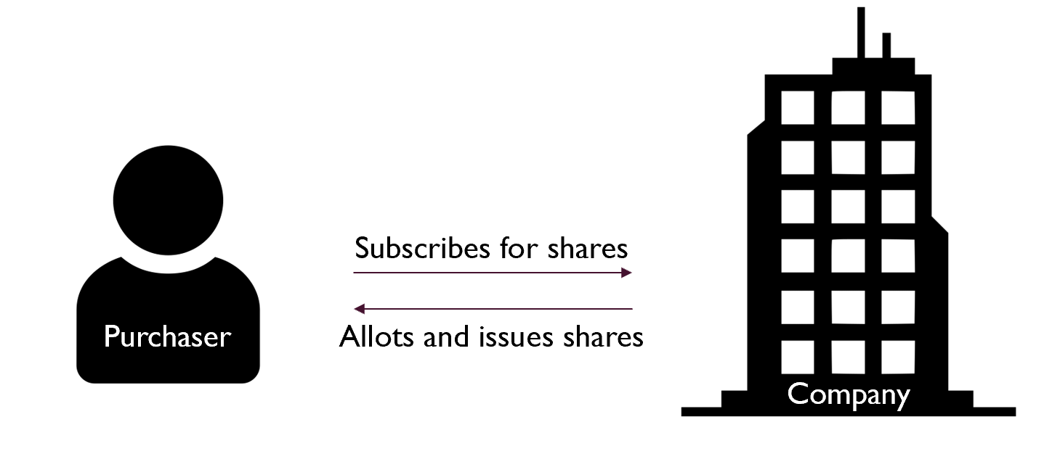
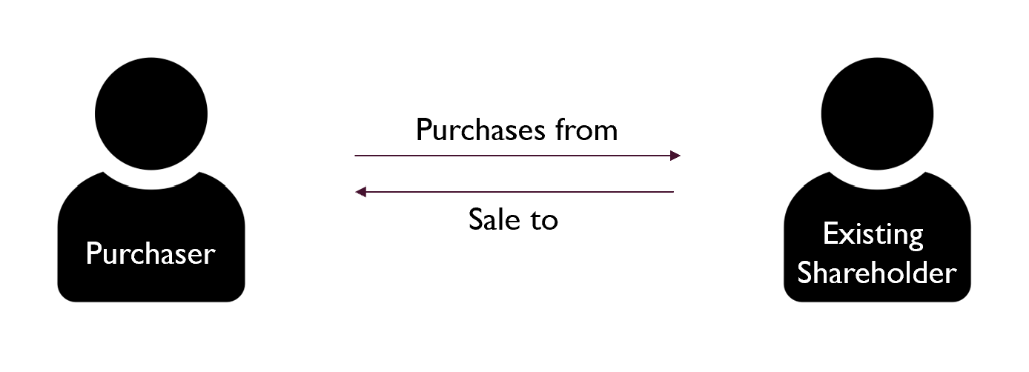
Motivation
The free transferability of shares allows dissatisfied shareholders to “exit” the corporation, conditional on a liquid secondary market for shares.
The secondary market for shares must be distinguished from the primary market for shares, where share issuances (e.g., in IPOs) and share buybacks occur.
Q: Does trading of a company’s shares on the secondary market affect the assets of a company? Why would the corporation’s managers be incentivized by what occurs on a secondary market for the company’s shares?
Q: Why is a shareholder’s “exit option” so dependent on the secondary market? What about the primary market for shares?
Primary Market
Secondary Market
Notes:
Share capital relates to the consideration (e.g., funds) which the shareholders have provided to the company in exchange for their shares.
Ans: No, it doesn’t. Exec comp.
Ans: Liquidation Protection. Can’t unilaterally withdraw capital from coy unless shs have collectively decided to liquidate position.

Slide 6
Motivation
Recall Slide Deck 4. In that seminar, we discussed how shareholders tend to be “rational, utility-maximizing” agents who understand how managers may act opportunistically against their own interests.
Bodie et al. (2014): “Several mechanisms have evolved to mitigate potential agency problems… compensation plans tie the income of managers to the success of the firm. A major part of the total compensation of top executives is often in the form of stock or stock options, which means that the managers will not do well unless the stock price increases, benefiting shareholders.”
When shareholders sell their shares on a liquid secondary market for the company’s shares, the aggregate supply of these shares increases, which in turn reduces the equilibrium price for the company’s shares.
By liquidity, we are referring to the the speed and the ease with which investors can realize the cash value of an investment. Illiquid assets, for example, real estate, can be hard to sell quickly, and a quick sale may require a substantial discount from the price at which the asset could be sold in an unrushed situation.
Q: What factors do you believe influence liquidity? Why is it essential to have securities regulations to guarantee a liquid secondary market for shares?
Notes:
Q: What do we mean by the “equilibrium price” for the company’s shares?
Ans: Liquidity: Number of people buying and selling shares at any given time (traders). Without securities regulations, insiders will sell their shares at a higher expected price than outsiders. Adverse selection problem where only insiders will trade.

Slide 7
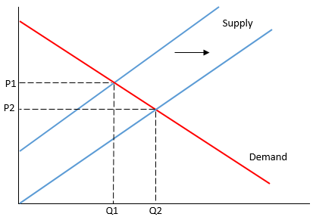
Motivation
Notes:
Where do these demand curves come from?

Slide 8
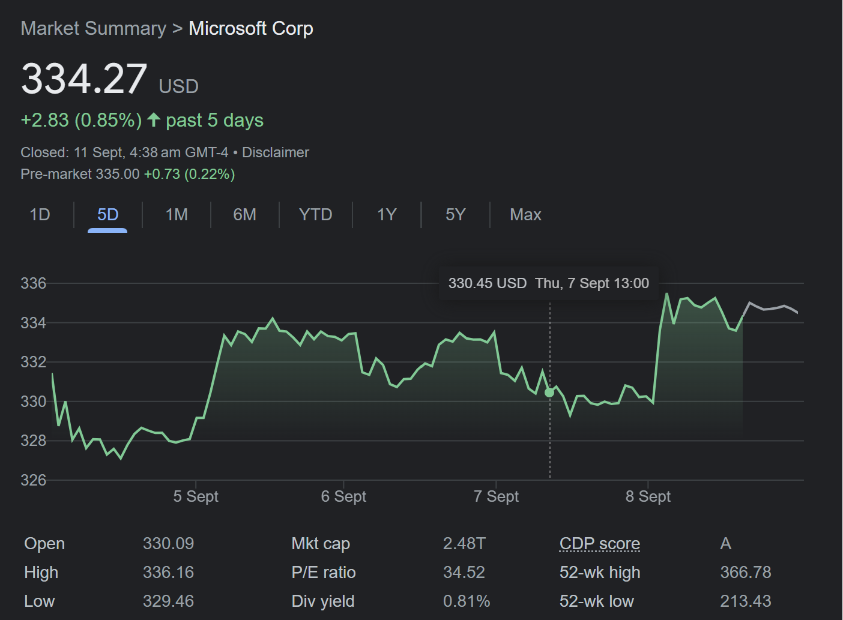
motivation
Is exit, or the threat of exit an effective way to discipline corporate managers?
This is a complex issue, due to the large number of factors which may incentivize/disincentivize shareholders to exit.
In the everyday trading of a company's shares on the financial exchanges, a vast array of information related to the firm may influence its stock value.

Slide 9
Motivation
Recall Slide Deck 4. Q: For a given decrease in the stock price of a corporation, how much of this decrease may be attributed to the actions of company managers? What about exogenous factors?
Q: If a company has 50,000 shareholders, will an individual shareholder be able to influence the market price of the corporation? Why, or why not?
Q: Consider a situation where a company is suffering from poor financial performance. Would a shareholder be incentivized to sell his/her shares given this situation? Would a prospective shareholder be willing to purchase shares in this company?
We will discuss some of these issues in the following slides.
First, let us turn to alternatives which a shareholder might have, other than through selling his/her shares in the relevant corporation.
Notes:
Macroeconomic Factors
Price Taker
Depends on whether you believe management will be replaced. If you sell, you put pressure on management. Same for activist shareholders.

Slide 10
Motivation
While a dissatisfied shareholder might be able to sell his/her shares on a secondary market, he/she might opt to harness the control rights attached to his/her shares as an alternative.
In Company Law, we learnt that shareholders procure control rights pursuant to the Companies Act and the Corporate Constitution (a similar case applies for jurisdictions other than Singapore).
In particular, a shareholder might choose to:
Use his/her voting rights to effect certain changes in the corporation (“Voting”).
This may include using votes to replace the board of directors.
Use his/her informational rights to engage managers of the corporation, aiming to convince them to follow a specific direction (“Engagement”).
Use his/her control rights to sue the managers of the corporation for a breach of duties, if such a breach were to exist (“Enforcement”).
Collectively, (1) to (3) are referred to as the shareholder’s “voice”.

Slide 11
Motivation
Thus, a dissatisfied shareholder must often decide whether to pursue a course of action consistent with exit or voice.
Accordingly, there has been an increasingly voluminous literature on the efficacy of exit vs voice, even in public corporations where both are available to a given shareholder.
Not obvious at all which should dominate. Why?
More generally, the tension between exit vs voice is a very general one. Hirschman, in his seminal book (1970) suggests (in the context of the deterioration of the quality of a firm’s product) that… “Management then finds out about its failings via two alternative routes : (1) Some customers stop buying the firm's products or some members leave the organization : this is the exit option. As a result, revenues drop, membership declines, and management is impelled to search for ways and means to correct whatever faults have led to exit. (2) The firm's customers or the organization's members express their dissatisfaction directly to management or to some other authority to which management is subordinate or through general protest addressed to anyone who cares to listen : this is the voice option. As a result, management once again engages in a search for the causes and possible cures of customers' and members' dissatisfaction.”

Slide 12
Diversification in financial markets
As detailed earlier, the tension between exit and voice seems to depend on a large number of factors.
Importantly, for our purposes, corporate and securities law may influence the costs associated with exit or voice.
Moreover, the decision of whether to render exit or voice (relatively) more effective via law is also a normative question.
Q: Why is this important? How does the Coase theorem interact with the mechanisms of voice and exit?
One important factor in determining the (relative) effectiveness of exit vs voice concerns a stylized fact regarding the diversification of shareholder ownership over the past few decades.

Slide 13
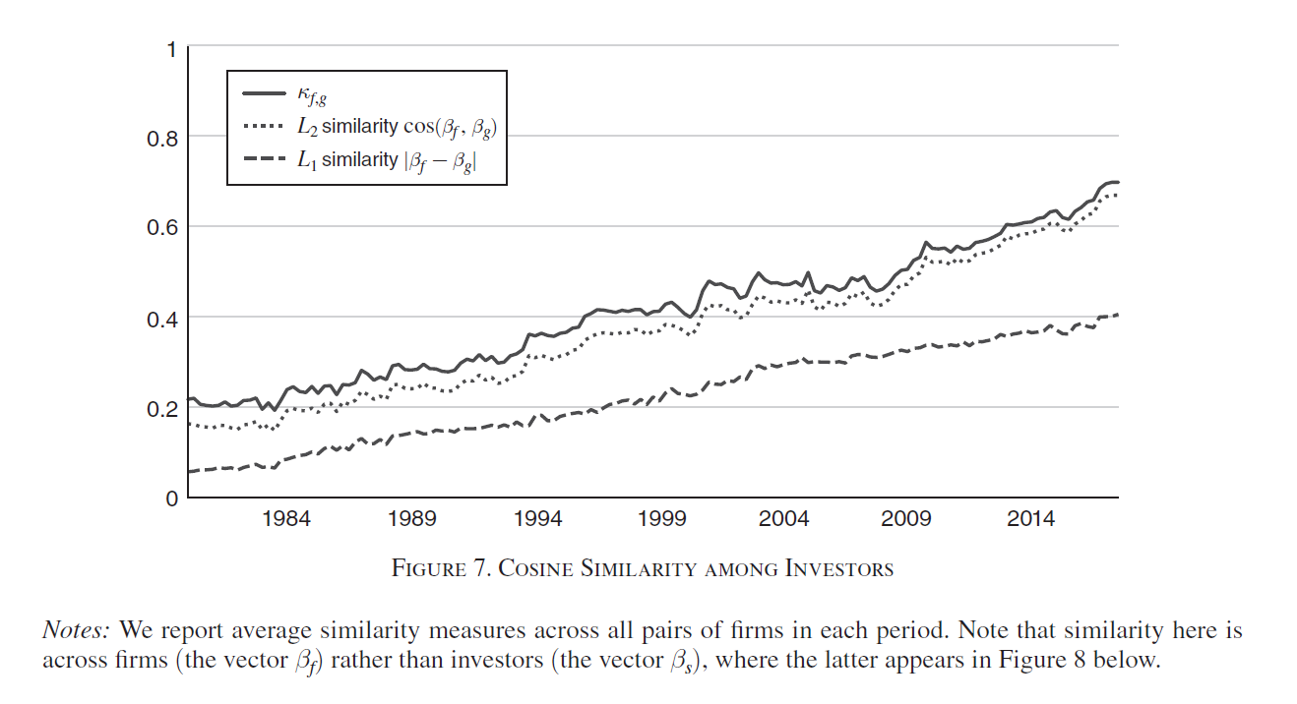
Diversification in financial markets
Backus et al. (2021)
Notes:
Within each firm, investors are looking more and more similar over time.

Slide 14
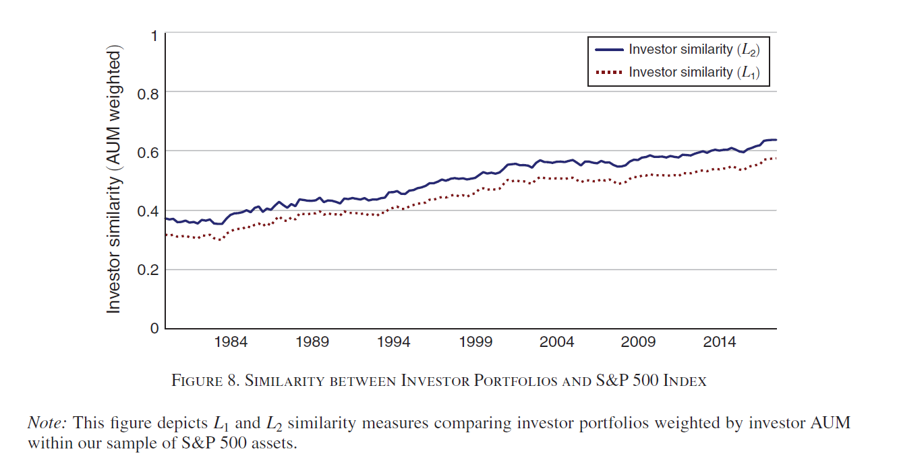
Diversification in financial markets
Backus et al. (2021)
Notes:
Across investors, portfolios are getting more and more similar over time.

Slide 15
Diversification in financial markets
Let’s assume that “voice” is not a practical option for a given shareholder. How would this shareholder value a given security?
Such a shareholder would only examine the expected risks and returns of a given security.
Bodie et al. (2014): “… if all else could be held equal, investors would prefer investments with the highest expected return. However, the no-free-lunch rule tells us that all else cannot be held equal. If you want higher expected returns, you will have to pay a price in terms of accepting higher investment risk. If higher expected return can be achieved without bearing extra risk, there will be a rush to buy the high-return assets, with the result that their prices will be driven up. Individuals considering investing in the asset at the now-higher price will find the investment less attractive: If you buy at a higher price, your expected rate of return (that is, profit per dollar invested) is lower. The asset will be considered attractive and its price will continue to rise until its expected return is no more than commensurate with risk. At this point, investors can anticipate a “fair” return relative to the asset’s risk, but no more. Similarly, if returns were independent of risk, there would be a rush to sell high-risk assets. Their prices would fall (and their expected future rates of return rise) until they eventually were attractive enough to be included again in investor portfolios. We conclude that there should be a risk–return trade-off in the securities markets, with higher-risk assets priced to offer higher expected returns than lower-risk assets.”

Slide 16
Diversification in financial markets
What if the investor is risk averse? How would the investor avoid risk in financial markets?
Recall our last seminar. There, we suggested that diversification related to the idea where many assets are held in the portfolio so that the exposure to any particular asset is limited.
Example from Bodie et al. (2014): “Suppose your portfolio is composed of only one stock, say, Dell Inc. What would be the sources of risk to this “portfolio”?... First, there is the risk that comes from conditions in the general economy, such as the business cycle, inflation, interest rates, and exchange rates. None of these macroeconomic factors can be predicted with certainty, and all affect the rate of return on Dell stock. In addition to these macroeconomic factors there are firm-specific influences, such as Dell’s success in research and development, and personnel changes. These factors affect Dell without noticeably affecting other firms in the economy.”
“Now consider a naive diversification strategy, in which you include additional securities in your portfolio. For example, place half your funds in ExxonMobil and half in Dell. What should happen to portfolio risk? To the extent that the firm-specific influences on the two stocks differ, diversification should reduce portfolio risk. For example, when oil prices fall, hurting ExxonMobil, computer prices might rise, helping Dell. The two effects are offsetting and stabilize portfolio return.”

Slide 17
Diversification in financial markets
Bodie et al. (2014): “But why end diversification at only two stocks? If we diversify into many more securities, we continue to spread out our exposure to firm-specific factors, and portfolio volatility should continue to fall. Ultimately, however, even with a large number of stocks we cannot avoid risk altogether, because virtually all securities are affected by the common macroeconomic factors. For example, if all stocks are affected by the business cycle, we cannot avoid exposure to business cycle risk no matter how many stocks we hold. When all risk is firm-specific… diversification can reduce risk to arbitrarily low levels. When common sources of risk affect all firms, however, even extensive diversification cannot eliminate risk. The risk that remains even after extensive diversification is called market (or systemic) risk, risk that is attributable to market-wide risk sources.”

Slide 18
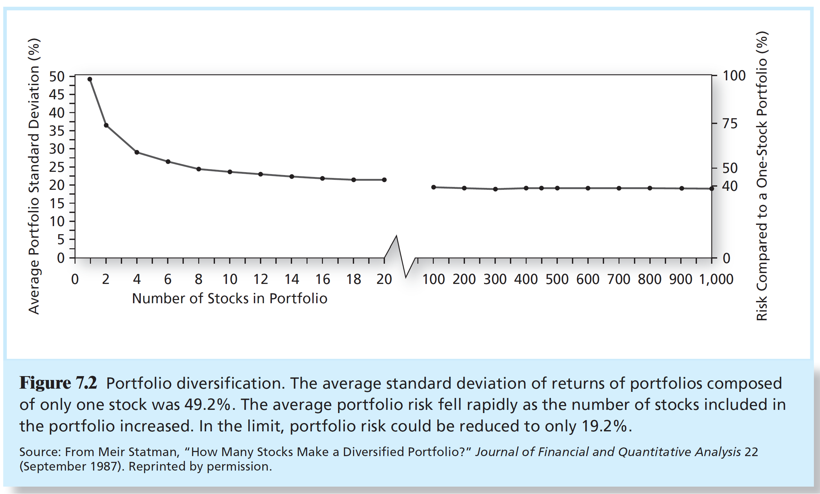
Diversification in financial markets

Slide 19
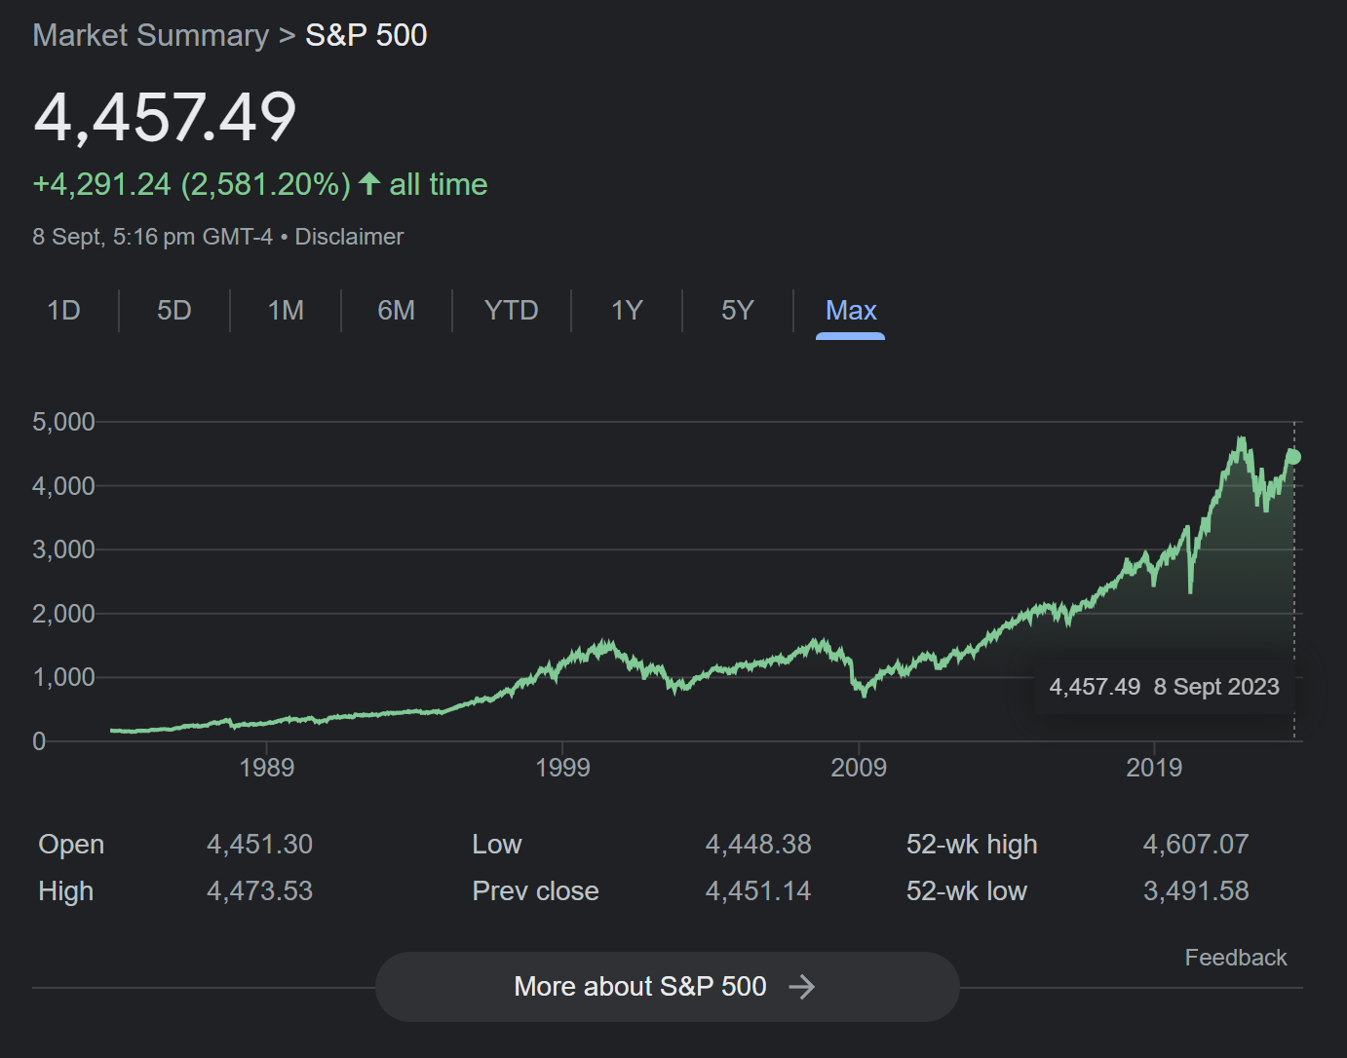
Diversification in financial markets
Notes:
2008 financial crisis, covid 19, etc.

Slide 20
Diversification in financial markets
A diversified investor is ostensibly “stuck between a rock and a hard place”, at least insofar when “exit” vs “voice” is concerned.
Voice – Gordon and Gilson (2017): “high-powered diversification and scale economies in active management-gives rise to significant problems in the efficient assignment of governance rights. As in the standard Berle-Means analysis, beneficial owners are rationally passive; governance rights are of little value to them. Institutional owners who are not seeking private benefits of control are rationally reticent; they also will assign a low value to governance rights since their proactive exercise will not improve the relative performance on which the institutional investor's profitability and ability to attract assets depends. As a result, institutions can be expected to be skilled at managing portfolios, not at developing more profitable alternatives to a portfolio company's business strategy, creating better governance structures for the firm, or mastering the skills of governance activism. The institutions' performance, and hence their success in attracting funds and earning profits, is evaluated by the performance of their portfolios, measured in comparative terms. In light of the mismatch between skills and incentives with respect to active company management, as opposed to portfolio management, governance rights will be chronically undervalued.”
Q: What about Exit?
Notes:
Relative performance – no difference because PORTFOLIOS ARE DIVERSIFIED.

Slide 21
Theoretical motivations
Admati and Pfleiderer (2009) note the large free-riding problems associated with exercising voice:
Active shareholders only realize a relatively small fraction of the benefits from monitoring while bearing the full costs. Thus, rational for other shareholders to “free-ride” on the efforts of active shareholders in exercising voice.
Q: How would active shareholders respond in response to “free-riding” by other passive shareholders?
If a large shareholder is aware that a firm's management does not act in the best interest of shareholders, it may be rational for the shareholder to follow the so-called "Wall Street Rule" or "Wall Street Walk," voting with his feet and selling his shares, rather than attempting to be active.
The threat of exit may be a form of shareholder activism… Presumably, if managers' compensation is tied to share prices, and if the exit of a large shareholder has a negative price impact, then the presence of a large shareholder who is potentially able to trade on private information may help discipline management and improve corporate governance.
Notes:
Ans: active shareholders are simply going to invest less in corp governance i.e. “voice”.

Slide 22
Theoretical motivations
One question that arises is whether the credible threat of selling can induce changes in managerial behavior.
“In fact, the threat to sell actually sounds more credible than the threat to mount a proxy fight, because a proxy fight is a costly and risky thing for a large shareholder,” said Admati… One way the model works is that a large shareholder obtains some information that the market does not have—for example, knowledge that a manager intends to purchase costly liability insurance for the firm. Based on that information, the large shareholder threatens to leave the firm, which in turn causes management to fear that the stock price would drop. Since most managers’ compensation depends at least in part on share price, this fear would theoretically motivate managers to take actions that were more in the interest of shareholders.
Q: From the shareholder’s point of view, why is this threat to sell credible? What is the crucial assumption made here?
Notes:
Crucial assumption made here: information that the market does not have, so shareholder will be more likely to make a profit if this shareholder sells.

Slide 23
Theoretical motivations
Admati and Pfleiderer’s paper makes a distinction between situations in which shareholders are trying to encourage management to take an action they deem beneficial, such as taking a bold research initiative, and situations where the conflict of interest involves shareholders attempting to prevent an action deemed “bad” for the investors, such as spending money on a corporate jet.
Calling these the “good action” and “bad action” scenarios, respectively, Admati says that although they may seem to be mirror images of each other, in fact whether and how effective the threat of exit is in disciplining managers can be dramatically different in the two scenarios.
What is the economic intuition here? Consider the effect of how market participants react when a blockholder sells his/her shares…

Slide 24
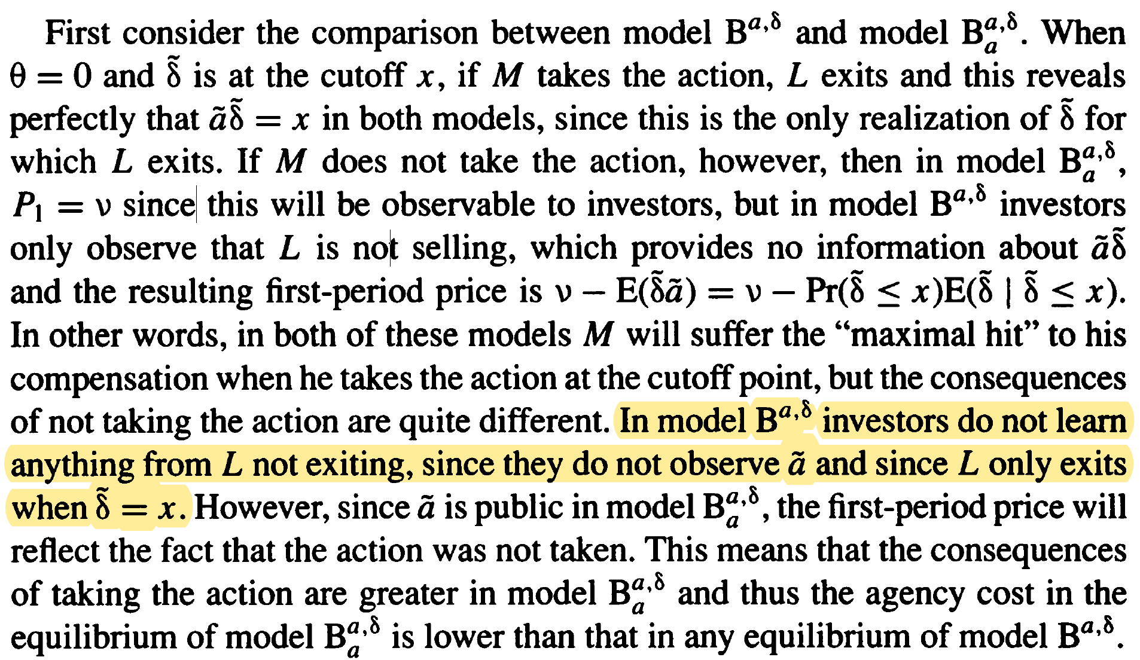
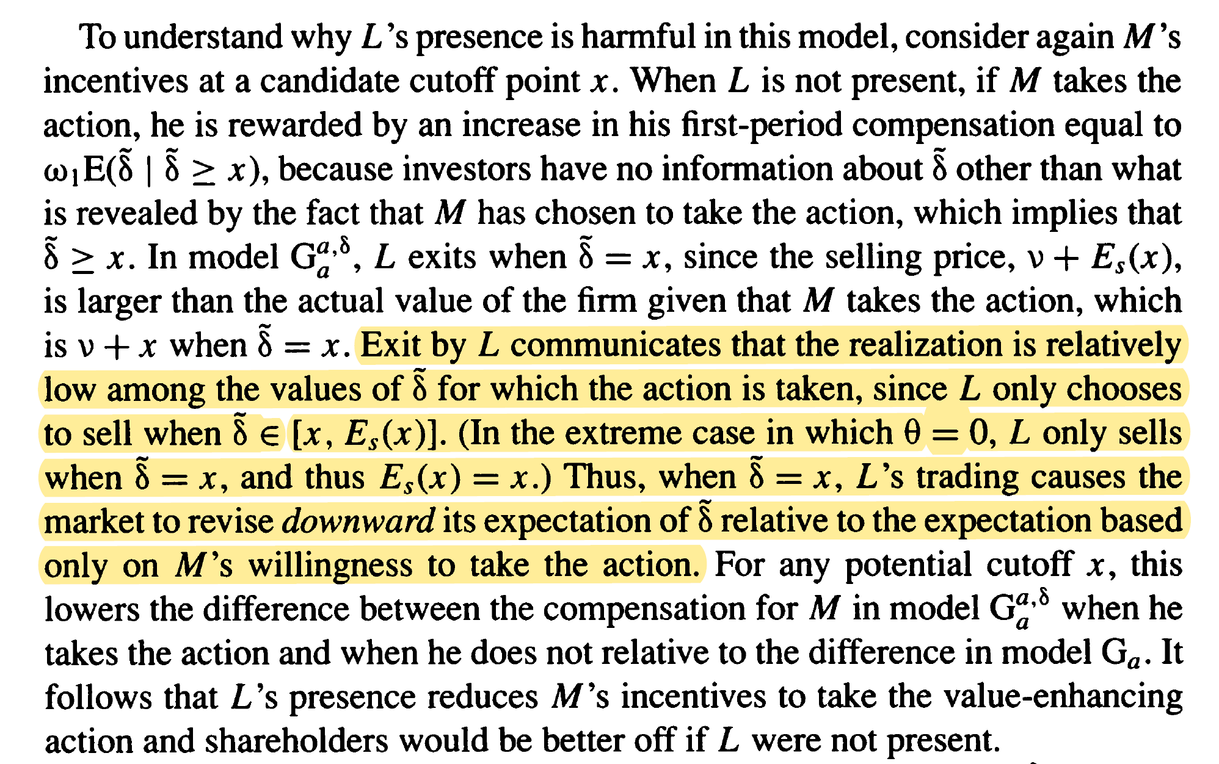
Theoretical motivations
“Bad Action”
“Good Action”
Notes:
1. The "Good Action" (Why $L$ hurts incentives):
When $M$ takes a good action, the market assumes it is a "home run" and prices the stock high.
$L$ knows the truth. If the action is a "base hit" (good, but not great), $L$ sells immediately because the stock is overpriced relative to reality.
This selling signals to the market: "This isn't a home run, it's just a base hit." The price corrects downward.
Because $M$ hates this price drop, they are afraid to take the action in the first place.
2. The "Bad Action" (Why $L$ doesn't help)
Context: $M$ is facing a loss and considers cutting a failing project.
The "Rare Exit" Trigger: $L$ only exits (sells) in one specific worst-case scenario: when $M$ takes the action, but the result is barely passing (the true value is exactly at the cutoff $x$). In this case, $L$ sells because the market is paying an "average" price (e.g., 50) for a "minimum" result (e.g., 10).
The Inference Problem: In almost all other cases—whether the project is a huge success (80) or if $M$ does nothing at all—$L$ holds onto their shares.
Why Silence is Uninformative: Because $L$ holds their stock in both "good" scenarios and "lazy" scenarios, the market cannot tell them apart. $L$'s silence is the default, uninformative state.
Result: Since $L$ staying quiet provides no signal, the market ignores $L$ entirely. $M$ is judged solely on whether the action itself is publicly visible, meaning $L$'s presence fails to add any discipline.

Slide 25
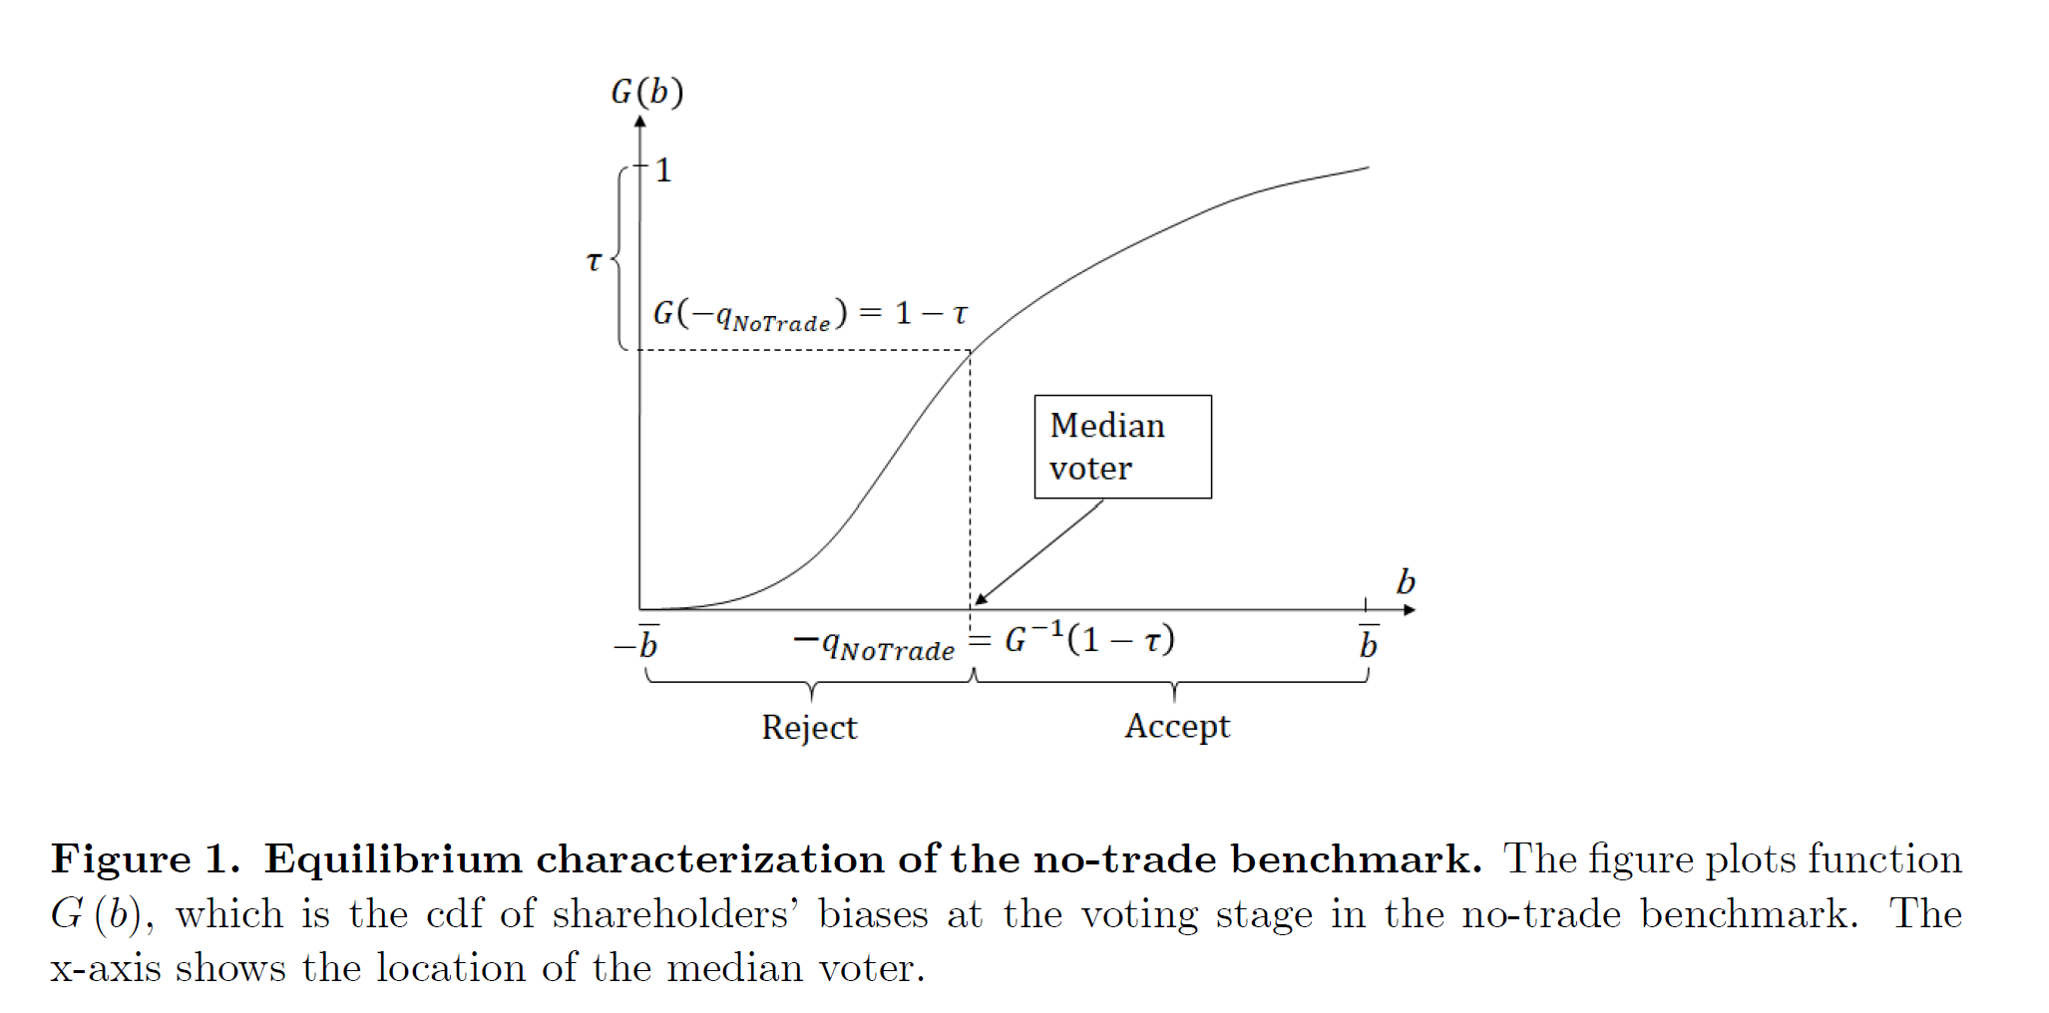
Theoretical motivations
Levit et al. (2019) examine shareholder voting in a model in which trading affects the composition of the shareholder base.
They show that trading and voting are complementary, which gives rise to self-fulfilling expectations about proposal acceptance and multiple equilibria.
What does this mean? Levit et al. (2019): “Median voter is always more extreme than the marginal shareholder”…
Notes:
If we can trade and vote, then if the vote doesn’t go in our favor, we will sell. This makes the base in turn more “conservative”, etc.

Slide 26
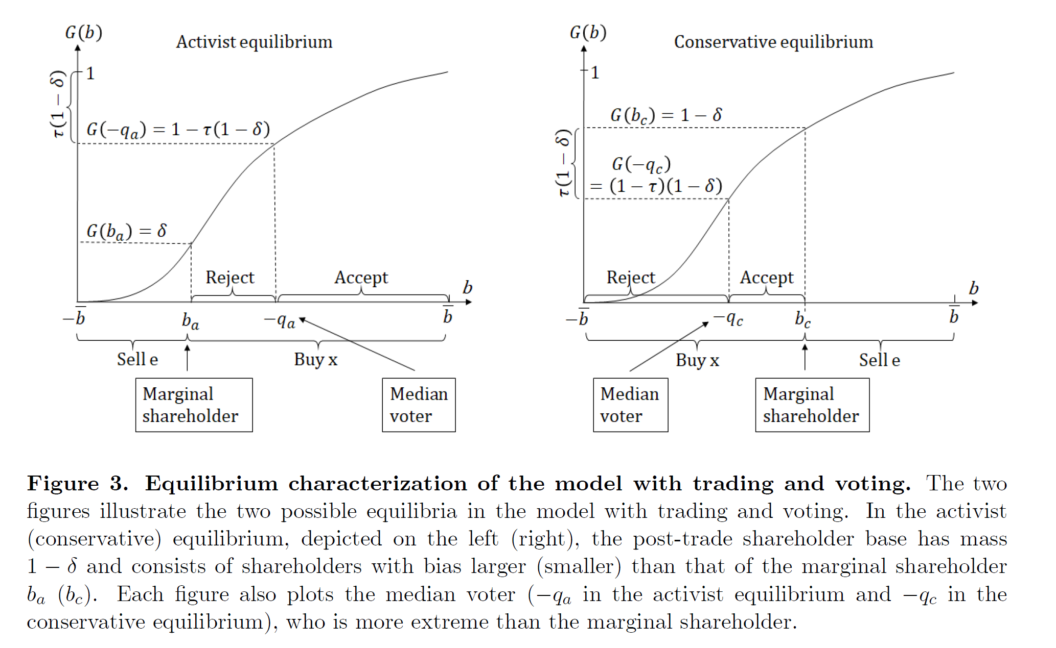
Theoretical motivations
Notes:
Marginal shareholder = shareholder who determines the price of the share – indifferent between buying and selling.
Median voter = shareholder who determines the result of the shareholder election.

Slide 27
Theoretical motivations
Broccado et al. (2021) study the relative effectiveness of exit (divestment and boycott) and voice (engagement) strategies in a world where companies generate externalities and some agents care about the social impact of their decisions.
They show that if the majority of investors are even slightly socially responsible, voice achieves the socially optimal outcome. In contrast, exit does not unless everybody is significantly socially responsible.
What is the central economic intuition driving their results?
Notes:
Answer given by following slides:
Exit is problematic for 3 reasons: First, unless there is a set of highly socially responsible investors (consumers) willing to pay for most of the cost of cleanup by themselves, the only equilibrium is one with zero exit and zero clean firms. Second, even when there are some very socially responsible investors (consumers), the impact on the environment is limited unless everybody is significantly socially responsible. Finally, individual incentives to join an exit strategy are not necessarily aligned with social incentives, and so exit can lead to a less desirable outcome than the one achieved when all individuals are purely selfish.
Selfish individuals benefit from a exit equilibrium.

Slide 28
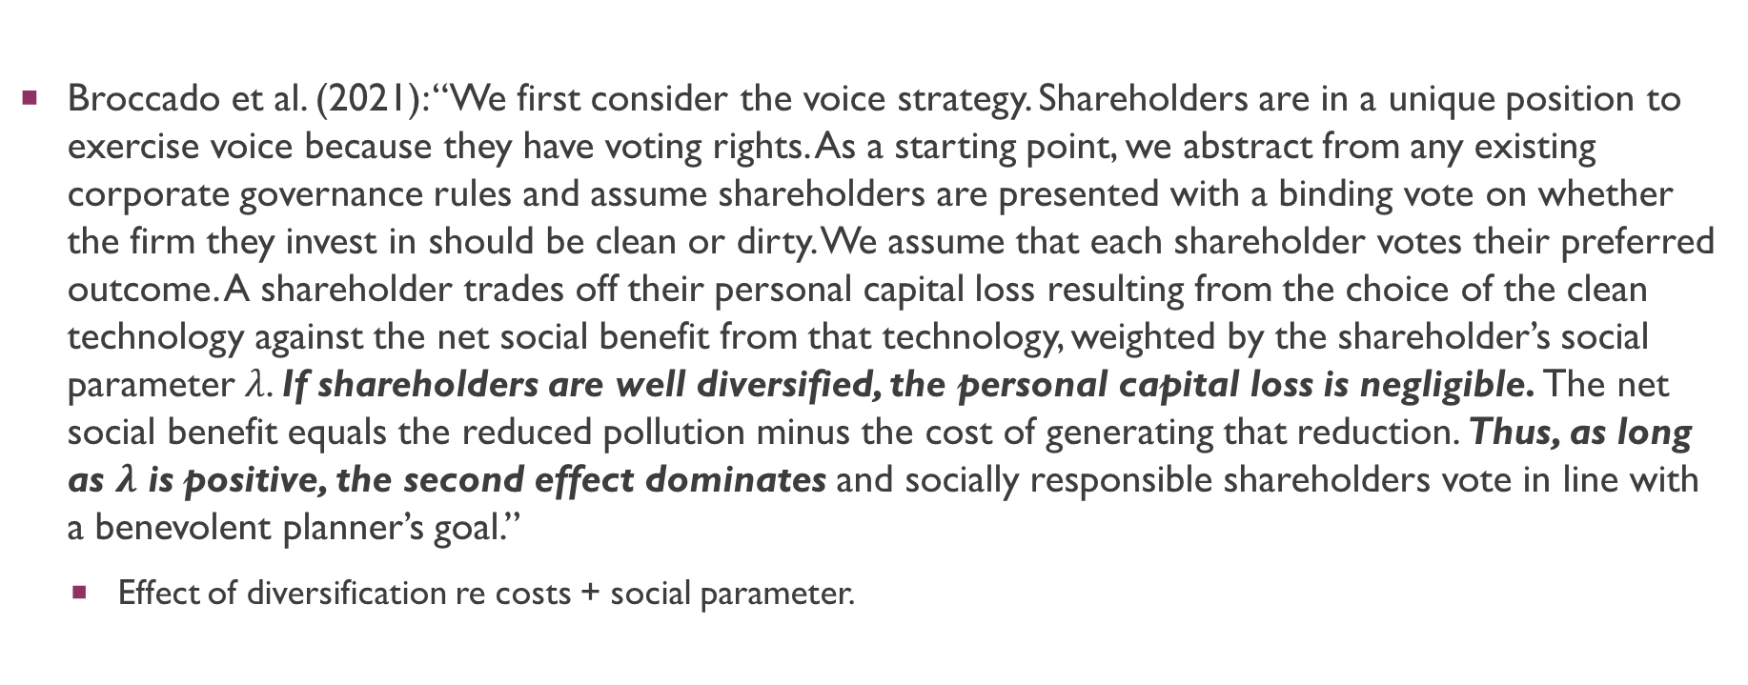
Theoretical motivations
Broccado et al. (2021): “We first consider the voice strategy. Shareholders are in a unique position to exercise voice because they have voting rights. As a starting point, we abstract from any existing corporate governance rules and assume shareholders are presented with a binding vote on whether the firm they invest in should be clean or dirty. We assume that each shareholder votes their preferred outcome. A shareholder trades off their personal capital loss resulting from the choice of the clean technology against the net social benefit from that technology, weighted by the shareholder’s social parameter $λ$. If shareholders are well diversified, the personal capital loss is negligible. The net social benefit equals the reduced pollution minus the cost of generating that reduction. Thus, as long as $λ$ is positive, the second effect dominates and socially responsible shareholders vote in line with a benevolent planner’s goal.”
Effect of diversification re costs + social parameter.

Slide 29
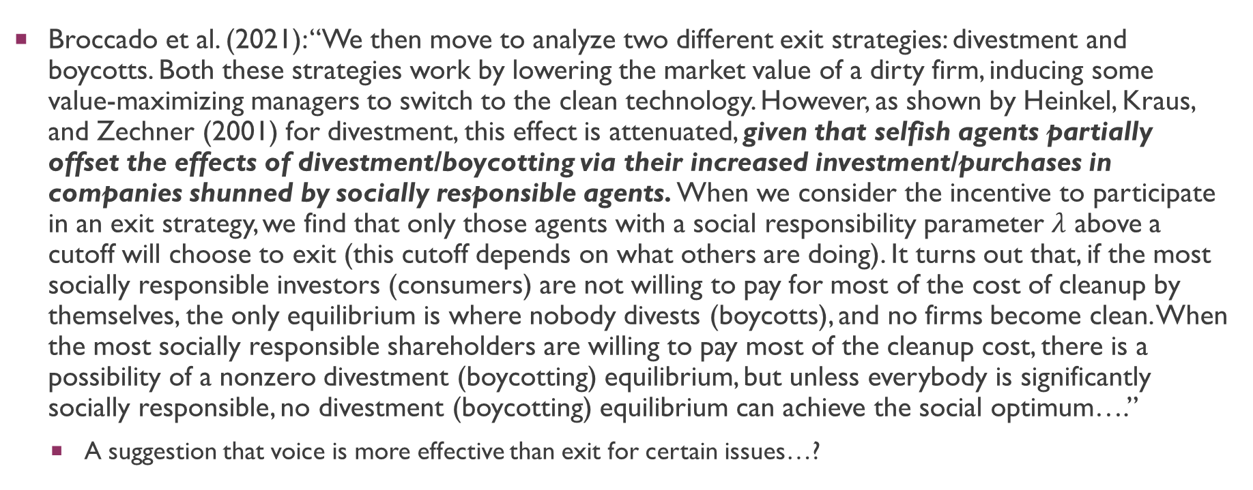
Theoretical motivations
Broccado et al. (2021): “We then move to analyze two different exit strategies: divestment and boycotts. Both these strategies work by lowering the market value of a dirty firm, inducing some value-maximizing managers to switch to the clean technology. However, as shown by Heinkel, Kraus, and Zechner (2001) for divestment, this effect is attenuated, given that selfish agents partially offset the effects of divestment/boycotting via their increased investment/purchases in companies shunned by socially responsible agents. When we consider the incentive to participate in an exit strategy, we find that only those agents with a social responsibility parameter $λ$ above a cutoff will choose to exit (this cutoff depends on what others are doing). It turns out that, if the most socially responsible investors (consumers) are not willing to pay for most of the cost of cleanup by themselves, the only equilibrium is where nobody divests (boycotts), and no firms become clean. When the most socially responsible shareholders are willing to pay most of the cleanup cost, there is a possibility of a nonzero divestment (boycotting) equilibrium, but unless everybody is significantly socially responsible, no divestment (boycotting) equilibrium can achieve the social optimum….”
A suggestion that voice is more effective than exit for certain issues…?

Slide 30
Empirical evidence
Li et al. (2021) examine how trading after shareholder meetings changes the composition of the shareholder base.
Analyzing daily trades, they find that mutual funds reduce their holdings if their votes are opposed to the voting outcome. Trading volume is high even when stock prices do not change, peaks on the meeting date, and remains high up to four weeks after shareholder meetings.
The results support models based on differences of opinion, which predict that shareholders’ beliefs may diverge more after observing voting outcomes. Hence, trading after meetings creates a more homogeneous shareholder base.
Consistent with the theoretical predictions of Levit et al. (2019).

Slide 31
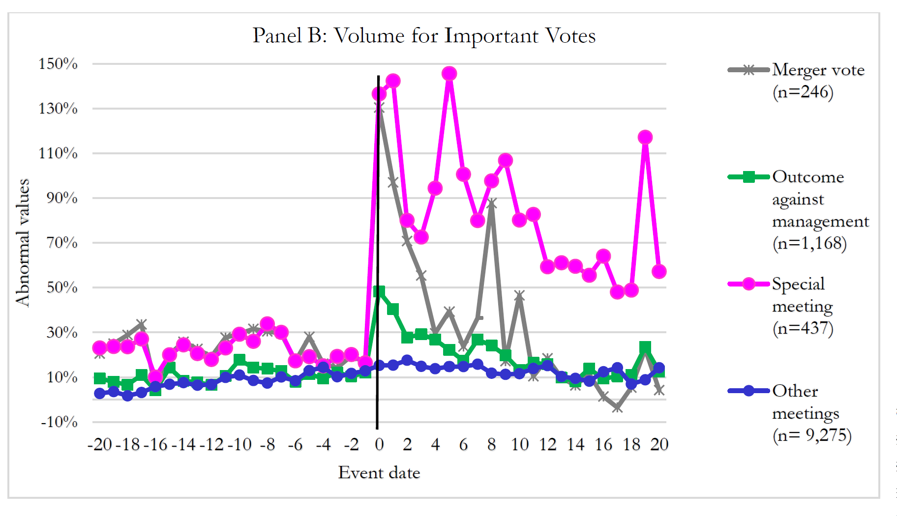
Empirical evidence

Slide 32
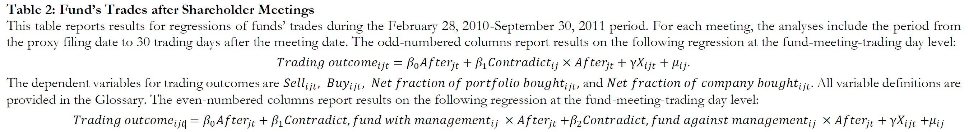
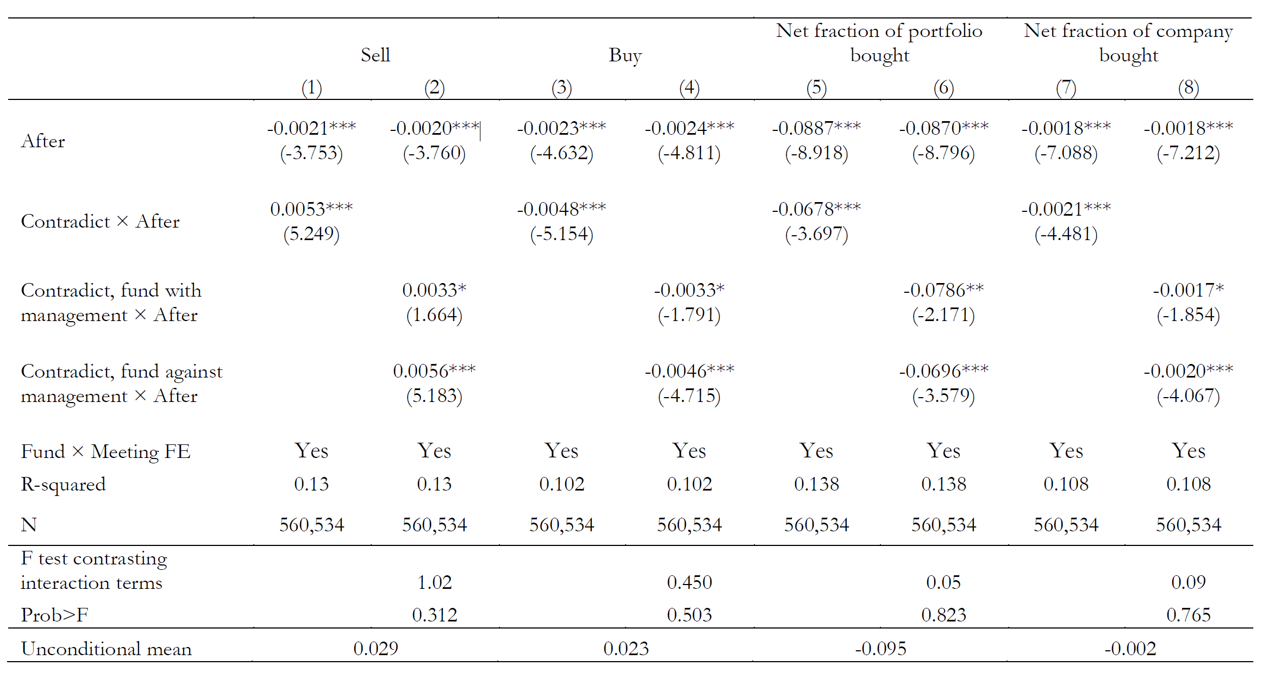
Empirical evidence
Notes:
Look at contradict x after. You sell more after the meeting if you contradict management.
Look at buy You buy LESS after the meeting if you contradict management.
You buy less of the company’s shares/as a fraction of the portfolio if you disagree with management.
Applies to both pro management funds and anti-management funds.

Slide 33
Empirical evidence
Becht et al. (2019) use proprietary data from a large UK active asset manager with a long-standing commitment to stewardship to examine the relationship between exit vs voice.
The authors show how fund managers’ decisions are influenced by monitoring target firms, especially through private engagements.
Internal analysts and a centralised stewardship team monitor the board and management and place portfolio companies on a watch list when there are governance or other concerns.
The asset manager engages more intensively with the watch list, abstaining or voting against management proposals in a third of meetings.
More intensive engagement and negative votes against are associated with internal analyst downgrades and with exit by fund managers.
More importantly, Becht et al. suggest that voice may influence exit.

Slide 34
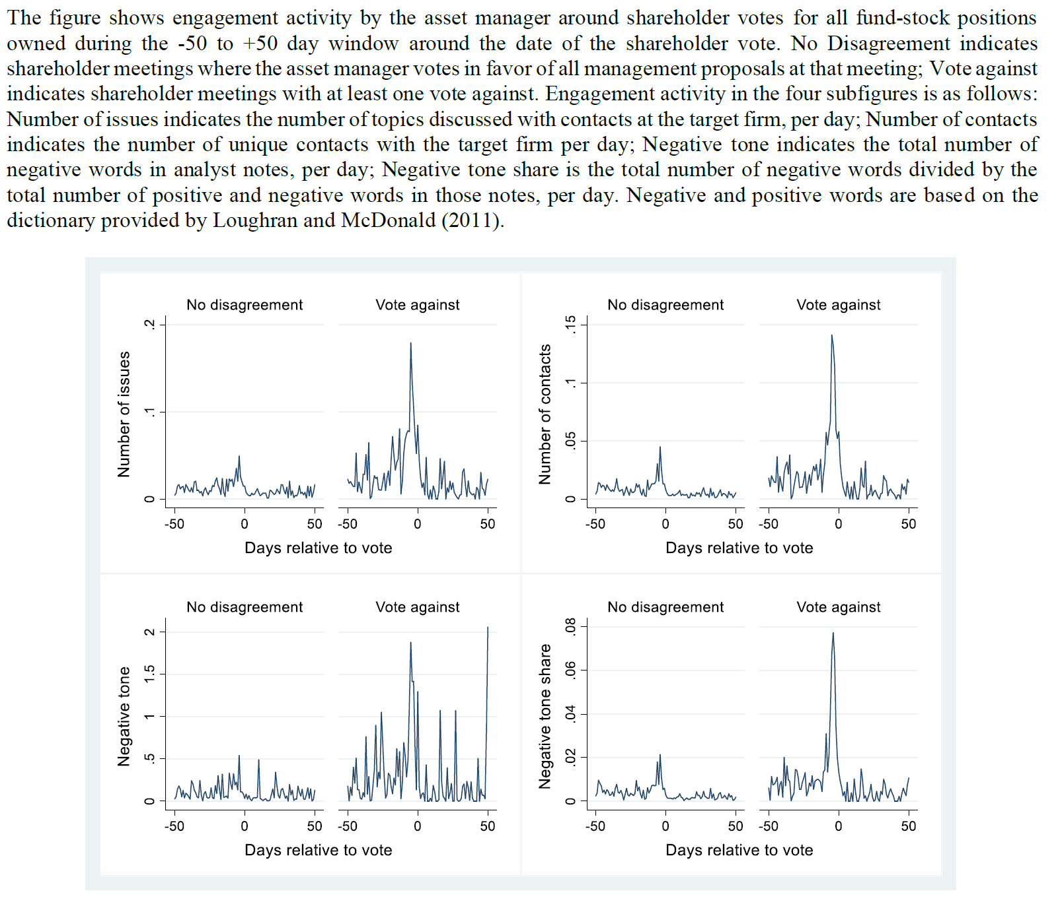
Empirical evidence
Notes:
Engagement is strongly correlated with disagreement.

Slide 35
Applications to law
Should the law facilitate exit or voice?
We know that this probably depends on the type of shareholder involved, but empirical evidence suggests that even (very) diversified shareholders engage in both, although direct evidence on engagements is difficult to observe.
One (partial) solution: Enable the role of institutional investors as financial intermediaries. What does this mean?
Q: What about Singapore’s context where share ownership is far more concentrated when compared to the U.S.?
What about private companies? See https://www.straitstimes.com/business/companies-markets/the-incredible-shrinking-singapore-stock-market
Is voice or exit more effective here? Should we rely solely on voice where controlling owners are dominant?
Notes:
Get around collective action problem viz financial intermediaries.
For CS jurisdictions, depends on whether you are CS or minority shareholder. If you are minority shareholder, voice limited to lawsuits (s 216 and s 216A). Otherwise, just exit.

Slide 36
Applications to law
In Singapore, s 176(1) of the CA states that “The directors of a company, notwithstanding anything in its constitution, shall, on the requisition of members holding at the date of the deposit of the requisition not less than 10% of the total number of paid-up shares as at the date of the deposit carries the right of voting at general meetings or, in the case of a company not having a share capital, of members representing not less than 10% of the total voting rights of all members having at that date a right to vote at general meetings, immediately proceed duly to convene an extraordinary general meeting of the company to be held as soon as practicable but in any case not later than 2 months after the receipt by the company of the requisition”.
If the directors fail to convene meeting within 21 days of the requisition, the requisitionists themselves can convene the meeting (s 176(3) CA)
C.f. position at U.S. where… shareholders generally have no power to “requisition” meetings concerning issues of interest but for the mechanism of “shareholder proposals” under Rule 14a-8.
Rule 14a-8 of the Securities Exchange Act of 1934 provides a framework allowing a public company shareholder to request that a proposal be included in the company’s proxy statement, to be voted upon at a company’s shareholder meeting. Q: Who sets the agenda for meetings in the U.S.?
Notes:
Managers set meeting.

Slide 37
Applications to law
Do corporate laws and governance even matter? Do financial markets provide alternative solutions? Consider the following:
Spamann (2022): “Portfolio investment in public corporate securities is a miraculous affair. Tens of trillions of dollars are entrusted to corporations and their managers by or on behalf of tens of millions of ultimate beneficiaries. The vast majority of these beneficiaries lack the time and expertise to value and manage these investments; most do not even try. And yet, several decades later, they get their money back with a sizeable return. What mechanisms ensure that their money is not squandered on bad investments or, once invested, lost to mismanagement or to transactions favoring savvier players? The standard answer is what I call direct investor protection: information and governance rights that investors scour and exercise themselves or through professional asset management—e.g., a mutual or pension fund. This paper’s answer is indirect investor protection: the ecosystem around public corporate securities obviates the need for information or governance rights for the vast majority of investors. A few others do the work—unintentionally or even unwittingly, con-strained by rules and competition.”

Slide 38
Applications to law
Spamann (2022): “The problems of direct investor protection are obvious for retail investors but extend far beyond them. Even large investors that have the skills, means, and incentives to process the information and exercise their rights often choose not to do so, for example pension funds in their passive portfolio or a hedge fund temporarily “parking” some money in a diversified portfolio. Other large investors may lack the skills. Retail investors clearly do. Retail investors cannot possibly digest the necessary information themselves. Their fund managers might, but theory and empirics suggest they will be at most partially effective. Passive (index) funds eschew selection of investments by definition and, competing on costs, have low incentives, if any, to exercise governance rights. Actively managed retail funds have better but, barred from charging performance fees, still weak incentives, and in any event have historically been mostly inactive in governance and notoriously underperformed the market, at least net of fees”

Slide 39
Applications to law
Spamann (2022): “Two main categories of indirect mechanisms protect in public markets. First, competition between speculators ensures that public market prices for stocks and other liquid securities are at least roughly equal to their fundamental value, obviating the need for careful selection of assets—including their governance—by investors and their agents. Second, once investors’ money is in-vested in a portfolio company, diversion or mismanagement of this money by the portfolio company’s managers or controlling shareholders is policed by plaintiff lawyers, activists, and takeovers... Speculators, plaintiff lawyers, activist hedge funds, and buyers are not motivated by a concern for the (other) investors. Nor are they legally mandated to have such a concern (with the partial exception of plaintiff lawyers). But under the rules in place, they (mostly) cannot make money without helping others. This is so in part because they constrain each other, i.e., the protection they provide is an emergent property of an interdependent ecosystem: plaintiff attorneys police collusion between activists, buyers, and management; prices informed by speculators constrain activists to value-enhancing interventions; buyers compete with each other for target firms; and speculators constrain each other by competing to eliminate pricing inaccuracies.”

Slide 40
Applications to law
Spamann (2022): “Indirect investor protection requires rules and their enforcement just like direct investor protection would. The difference is which private actors fulfill which important roles, and hence which rules are important. Indirect investor protection requires rules restricting its protagonists to gain if and only if (other) investors gain, and that steer unsophisticated investors into markets where the indirect mechanisms are active. This analysis unifies the evaluation of well-under-stood issues such as attorney fee awards and 13D disclosures. It also elucidates otherwise puzzling rules, such as those forcing open-end mutual funds to hold mostly liquid assets…”
Q: What is the key driver of Spamann’s argument? How is “indirect investor protection” distinct from [otherwise] “direct investor protection”?
Notes:
“Enabling markets through mutually beneficial transactions” to take place.

Slide 41
Q&A
See you guys on Tue.

